Slide 1


Slide 2


Slide 3
STARTER
UNIT
Lesson 3
Vocabulary
Prepositions
and
Everyday objects

Slide 4

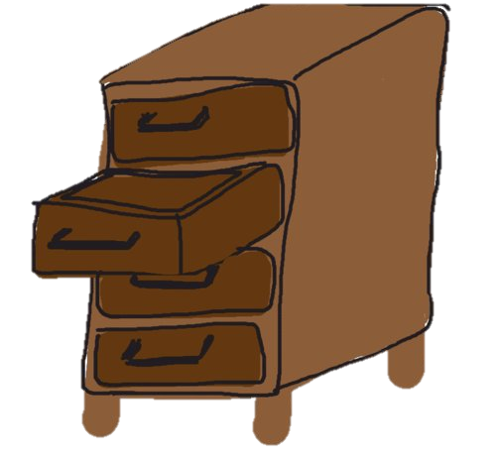
New words
Poster (n) /ˈpoʊ.stɚ/
Drawer (n) /drɑː/

Slide 5
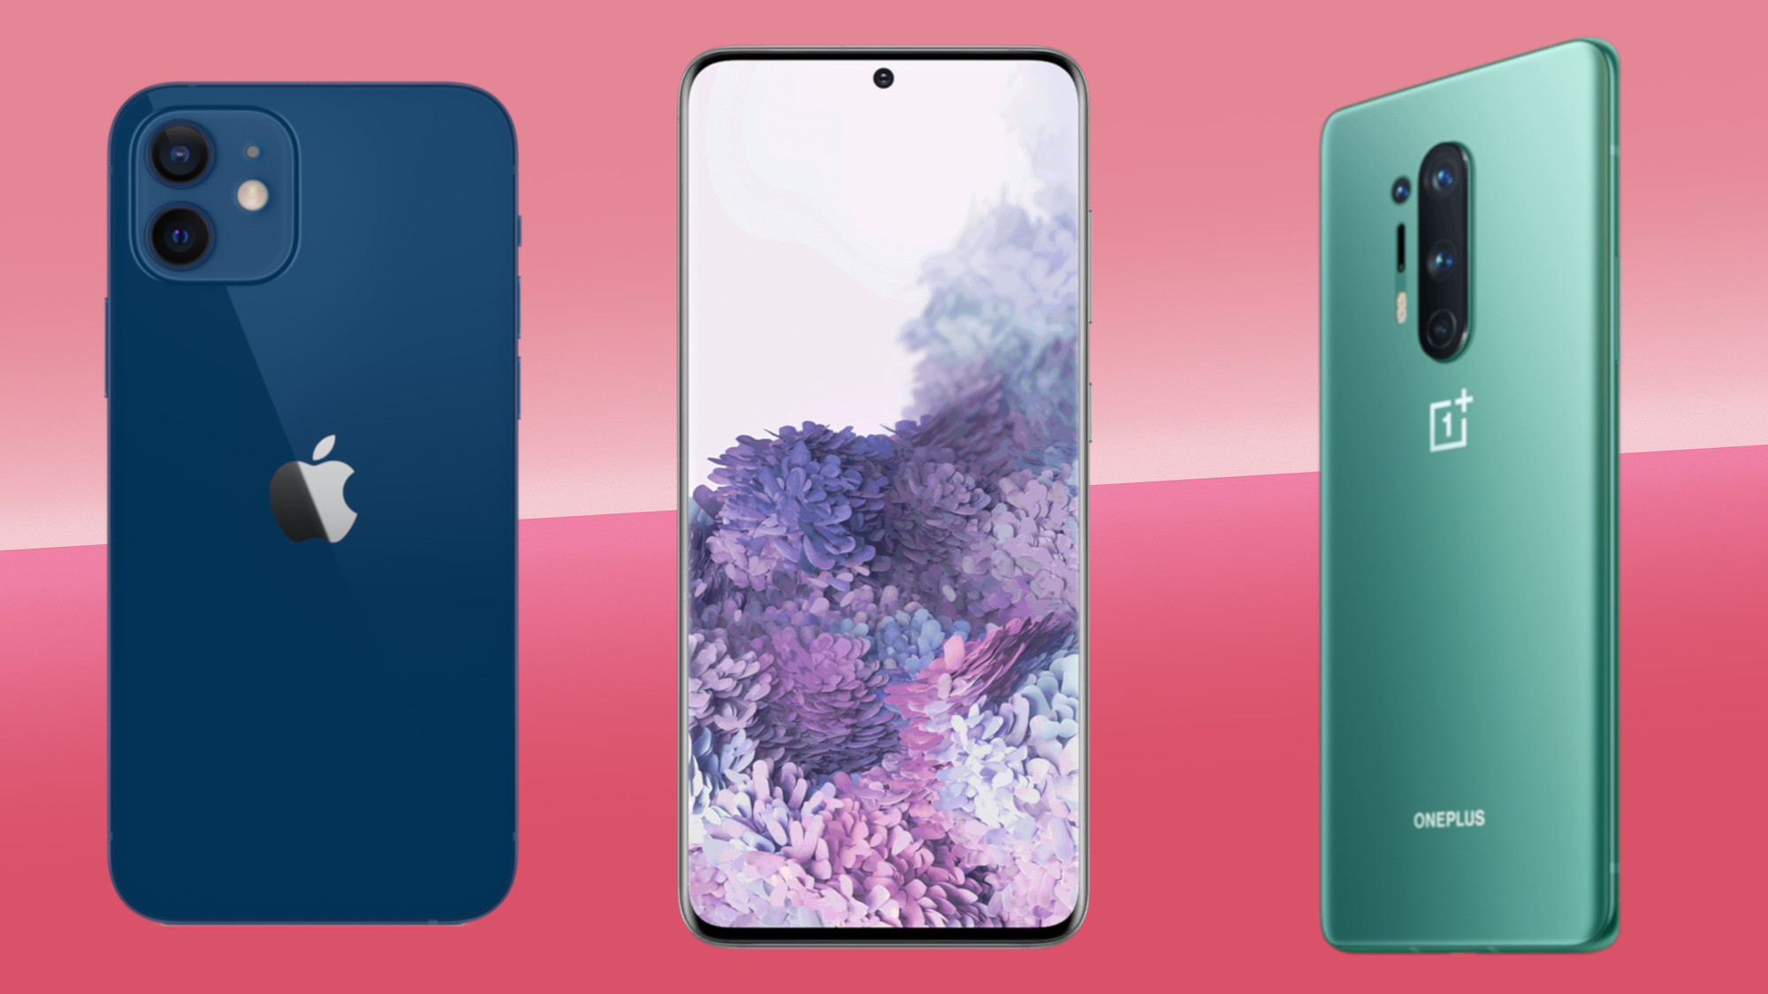

New words
Mobile phone (n)
/ˈmoʊ.bəl/ /foʊn/
Clock (n) /klɑːk/

Slide 6
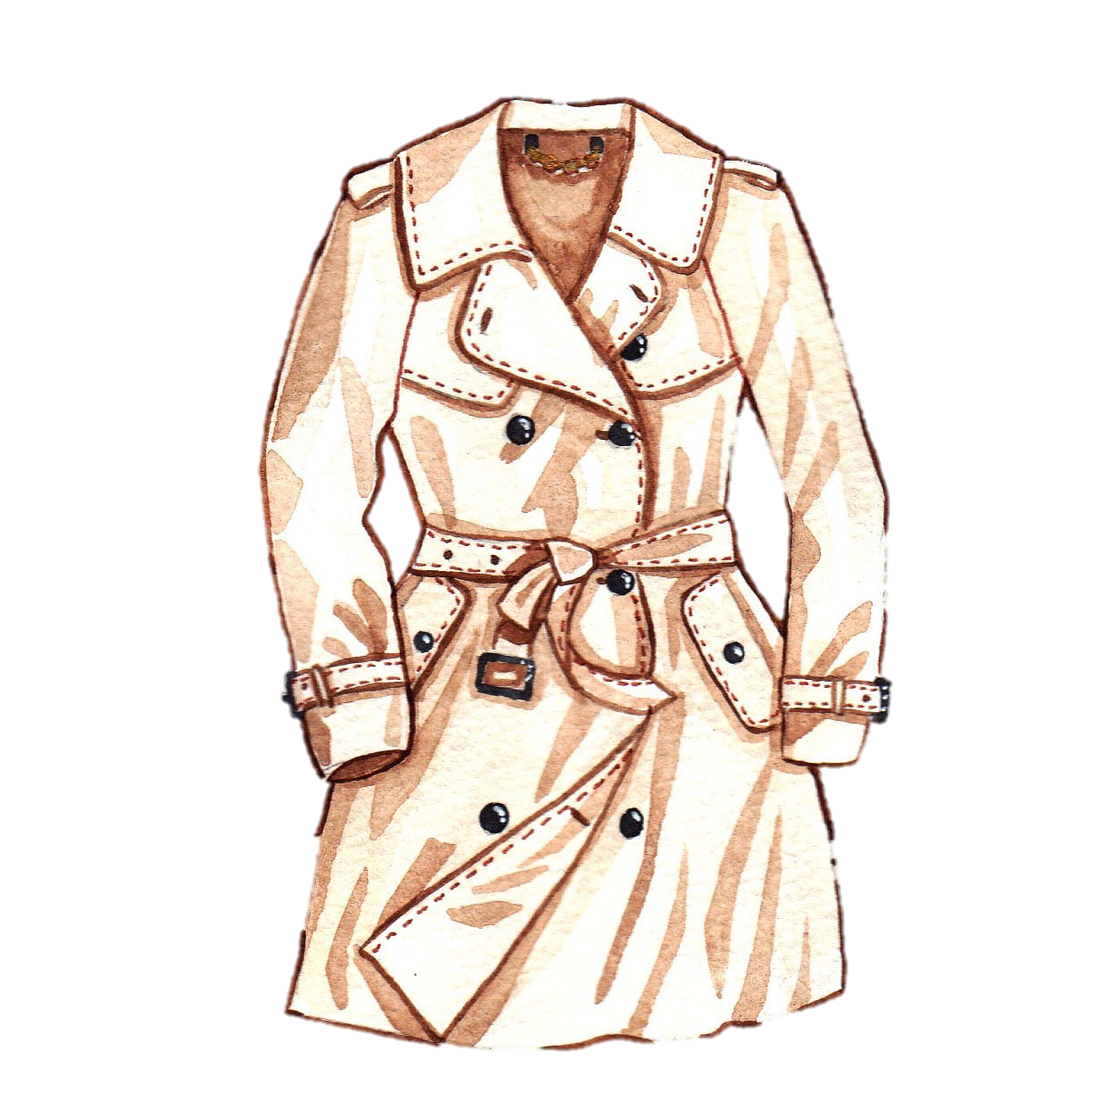

New words
Dictionary (n) /ˈdɪk.ʃən.er.i/
Coat (n) /koʊt/

Slide 7
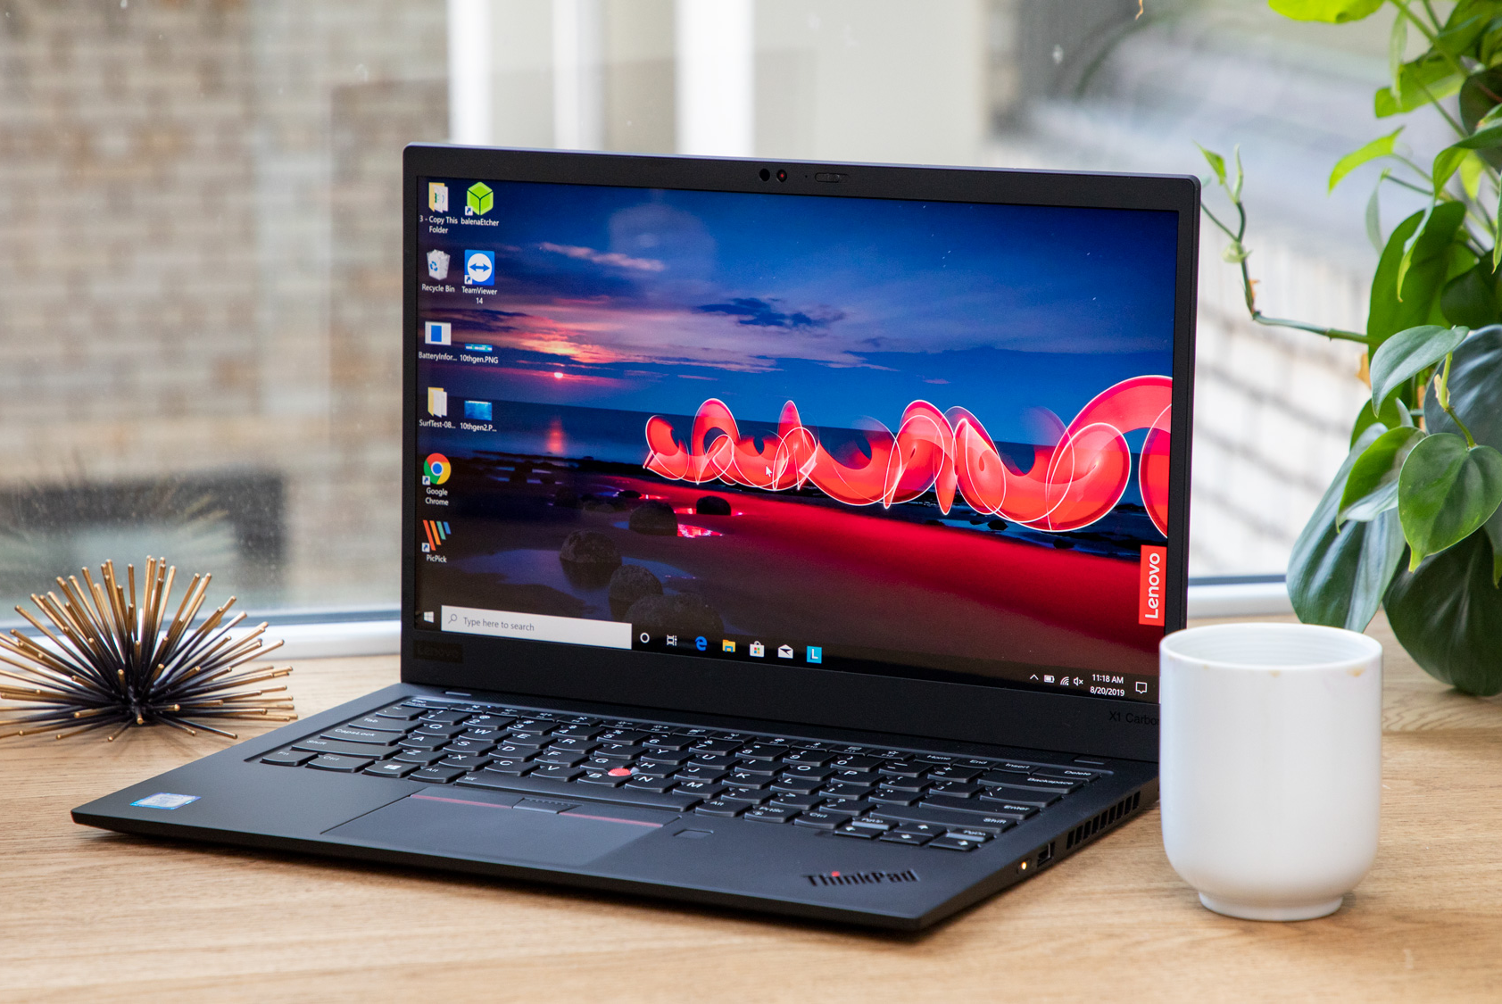
New words
laptop (n)
/ˈlæp.tɑːp/

Slide 8
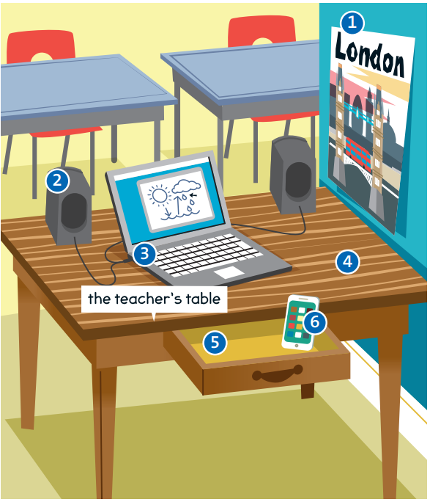
1. poster
2. speaker
4. table
3. laptop
6. mobile
phone
5. drawer

Slide 9
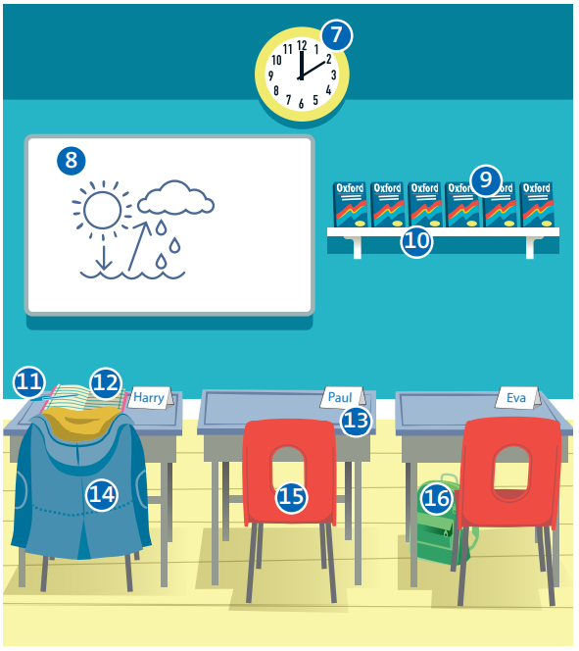
7. clock
8. board
9. dictionaries
10. shelf
11. pen
13. desk
12. notebook
14. coat
16. bag
15. chair

Slide 10
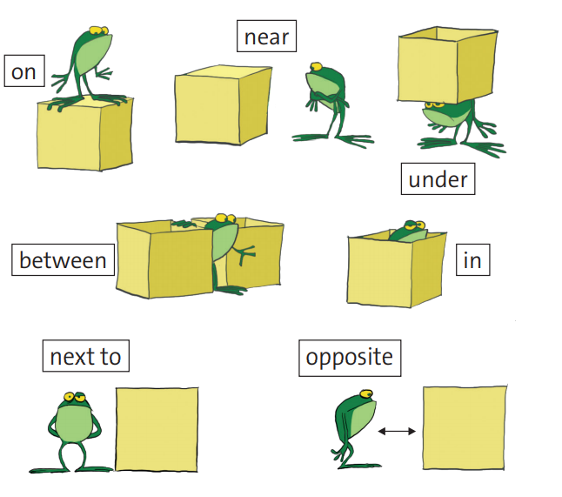

Slide 11
Exercise 3
on
1. The dictionaries are _______the shelf.
2. The teacher’s mobile is ______ the drawer.
3. The laptop is __________ the speakers.
4. The students’ chairs are _____ their desks.
5. The poster is ________ the teacher’s table.
in
between
under
next to

Slide 12
on
6. Harry’s coat is _______ his chair.
7. Eva’s bag is ________ her desk.
8. The clock is ________ the board.
9. The board is _______ the students’ desks.
10. Harry’s pen is _________ his notebook.
under
near
opposite
on

Slide 13
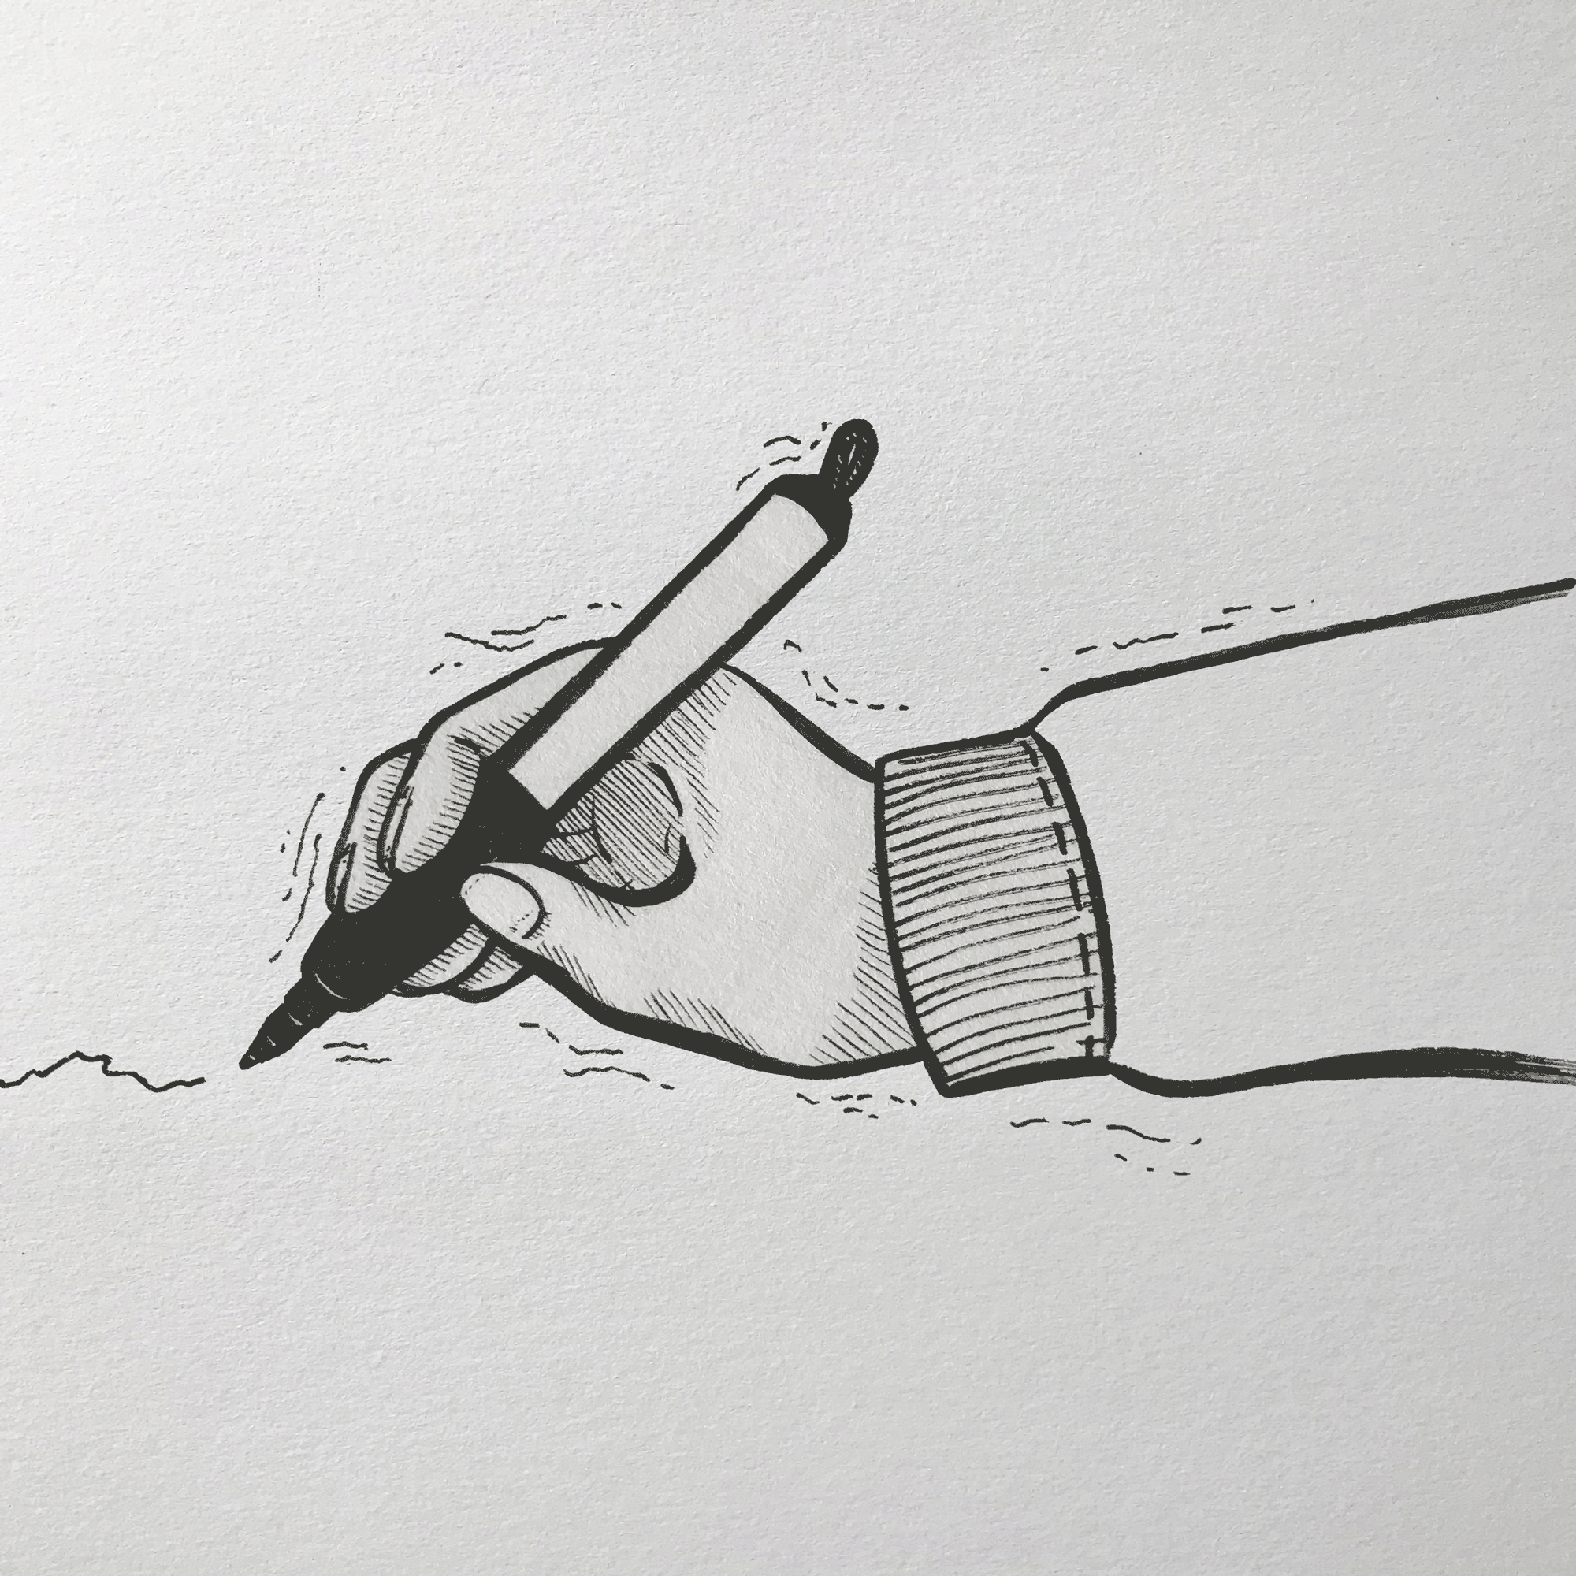
Draw a picture

Slide 14

WRITING
In my picture, a laptop is on the....

Slide 15

Work in pairs
In my picture, a laptop
is on the desk. ..
…...

Slide 16

- Learn by heart all the new words
- Prepare for next lesson – Language focus: Possessive " 's "

